Slide 1


®

Slide 2



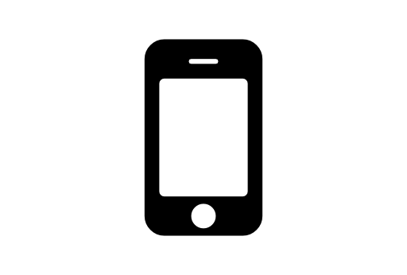

Fast, Light, Complete
70+ jQuery-based UI widgets in one toolset
JS Framework Agnostic | No lock in
AngularJS Integration | Bootstrap Theme Extensive Data Visualization Support Mobile Specific Widgets | App Tooling Touch Support | Adaptive Rendering
Modern Comprehensive HTML5/JS Framework

Slide 3

Why Kendo UI?
Everything you need, in one neat package

Slide 4



What's in the Box?
The different parts of Kendo UI
Application Framework Web UI
Mobile UI
Data Visualization

Slide 5
Web UI
30 Widgets (and growing...)
AutoComplete Button Calendar ColorPicker ComboBox DatePicker DateTimePicker DropDownList Editor
Grid ListView
MaskedTextBox Menu MultiSelect Notification NumericTextBox PanelBar PivotGid ProgressBar Scheduler
Slider Sortable
Splitter TabStrip TimePicker ToolBar Tooltip TreeView Upload Window

Slide 6
Mobile UI
A complete application toolset for building hybrid and mobile web applications
ActionSheet ButtonGroup Drawer Forms ListView MobileButton ModalView NavBar PopOver Scroller
ScrollView SplitView Switch TabStrip

Slide 7
Data Vizualization
Charts / Graphs/ Other Visuals
Area Charts Bar Charts Barcode
Box Plot Charts Bubble Charts Bullet Charts Chart API Diagram Donut Charts
Funnel Charts Gantt
Line Charts Linear Gauge Map
Pie Charts Polar Charts QR code Radar Charts
Radial Gauge Range Bar Charts Scatter Charts Sparklines
Stock Chart TreeMap Waterfall Charts

Slide 8
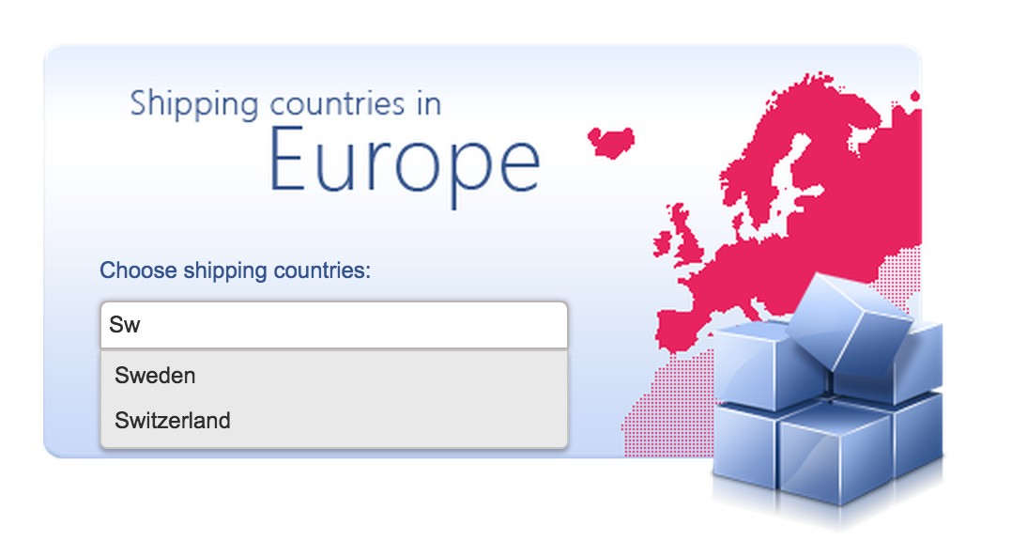
From the very Simple
A Kendo UI AutoComplete Widget

Slide 9
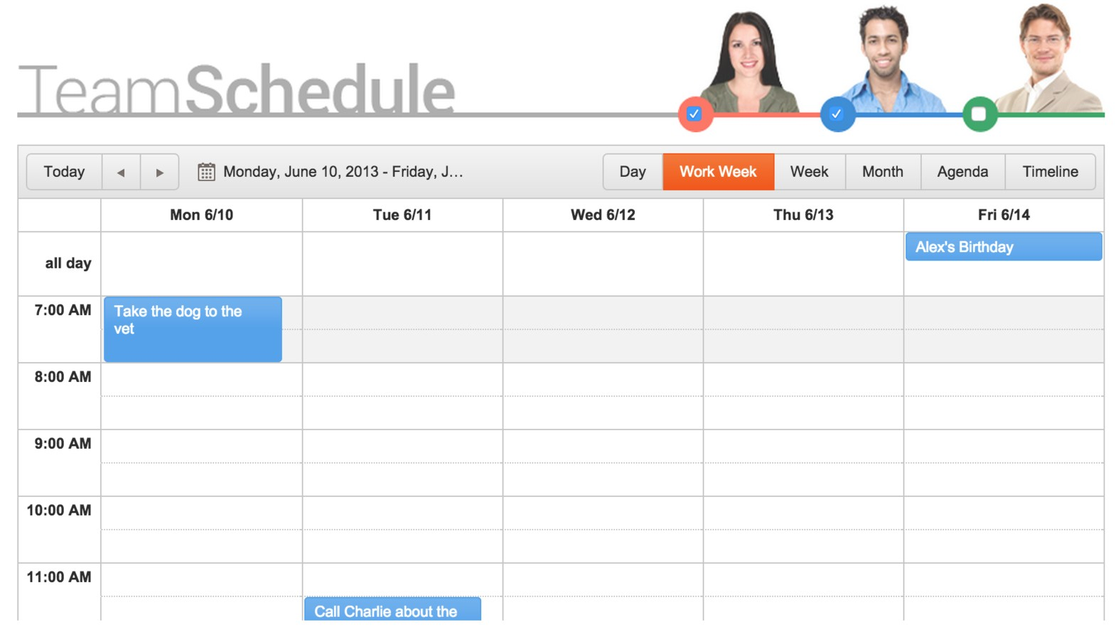
To the very Complex
A Kendo UI Scheduler

Slide 10
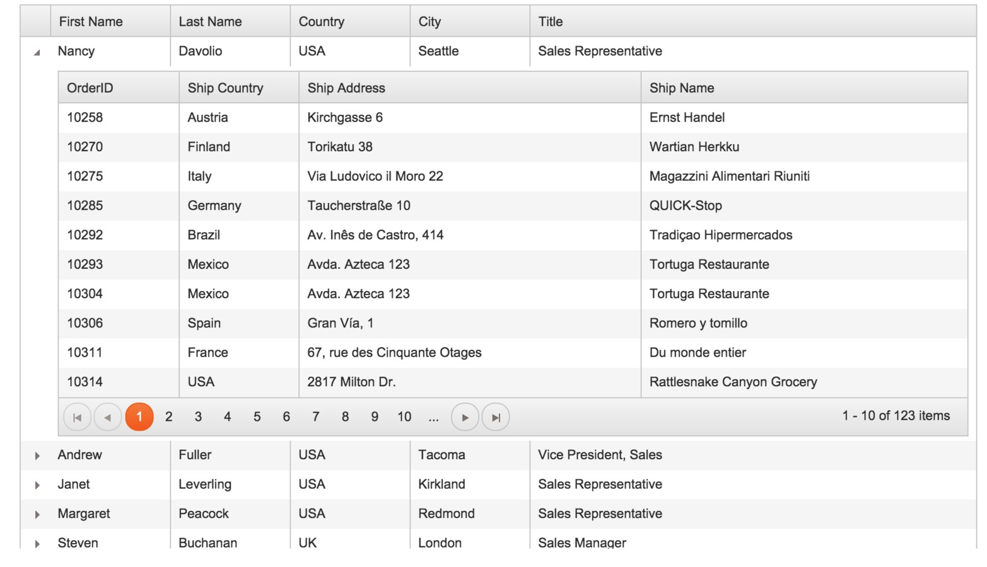
From Web essentials
A Kendo UI Grid

Slide 11
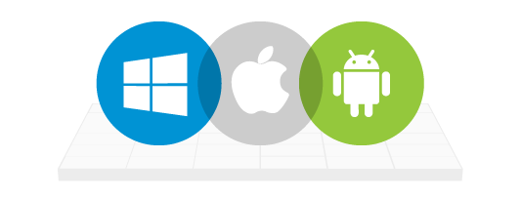
To Mobile
A Kendo UI Mobile ActionSheet
Yes, this works Cross-Platform .. And renders adaptively!
Ready?

Slide 12
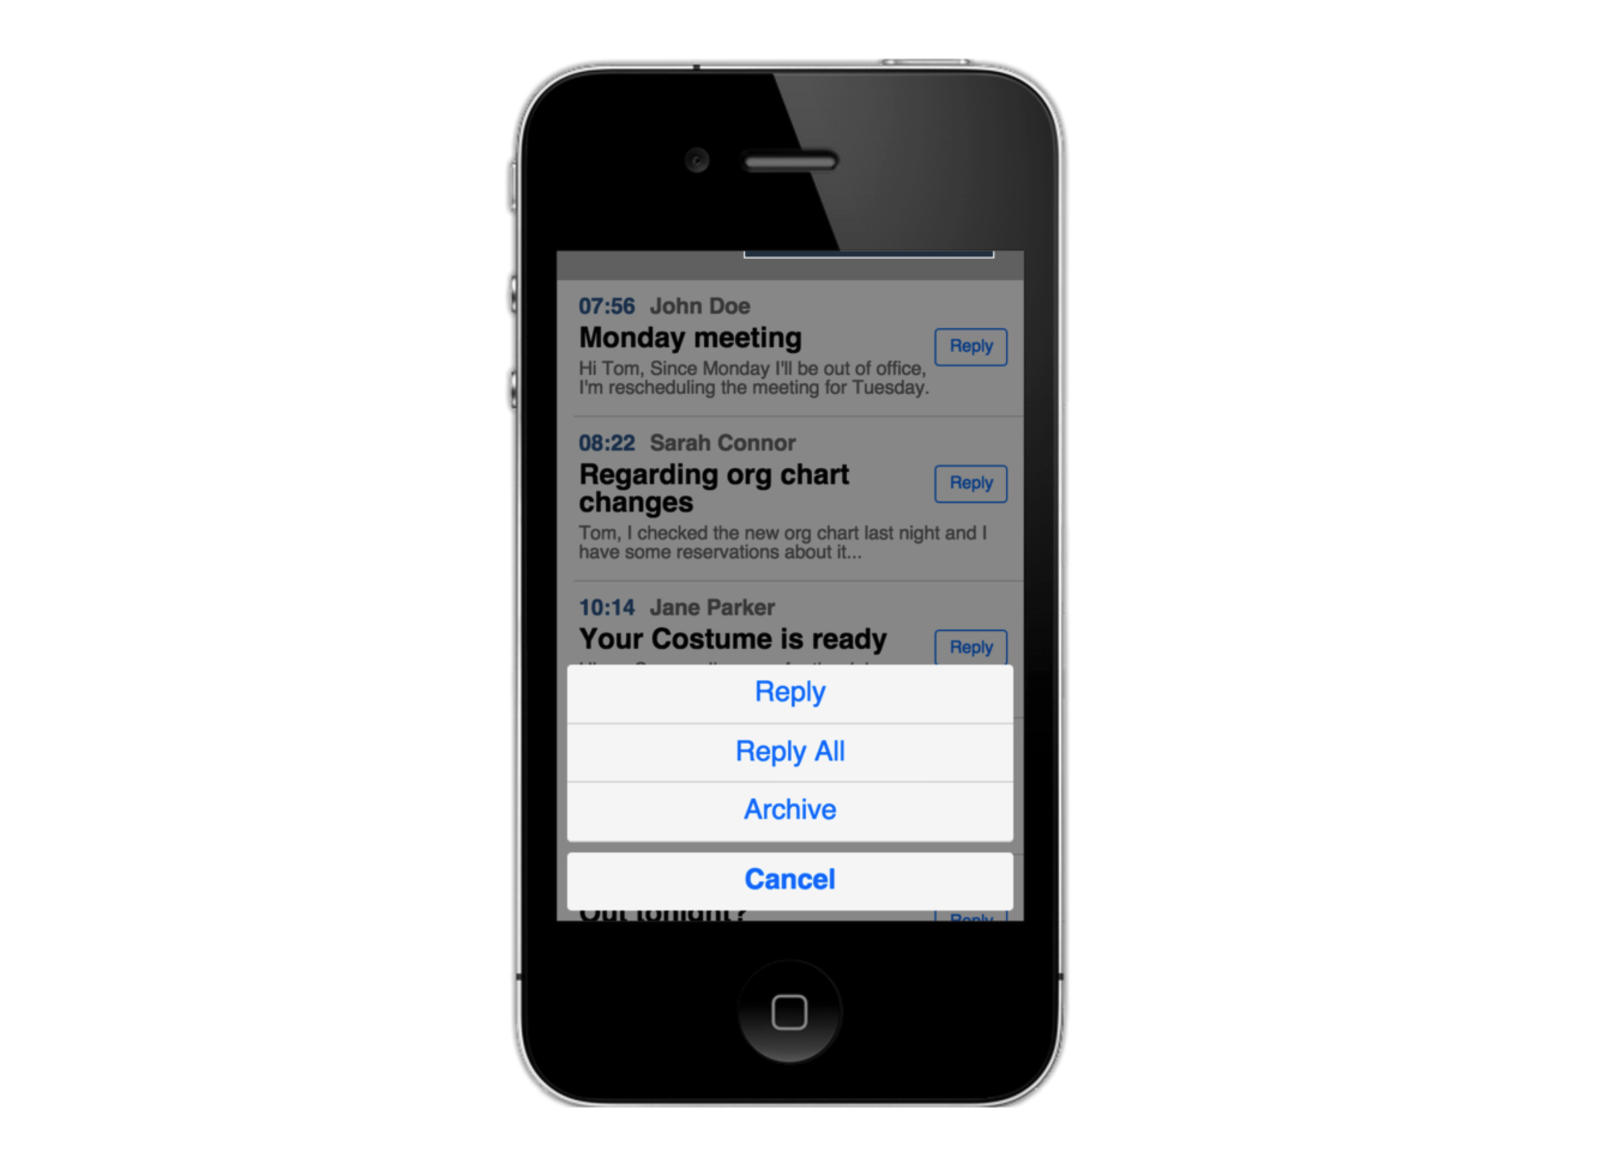

Slide 13
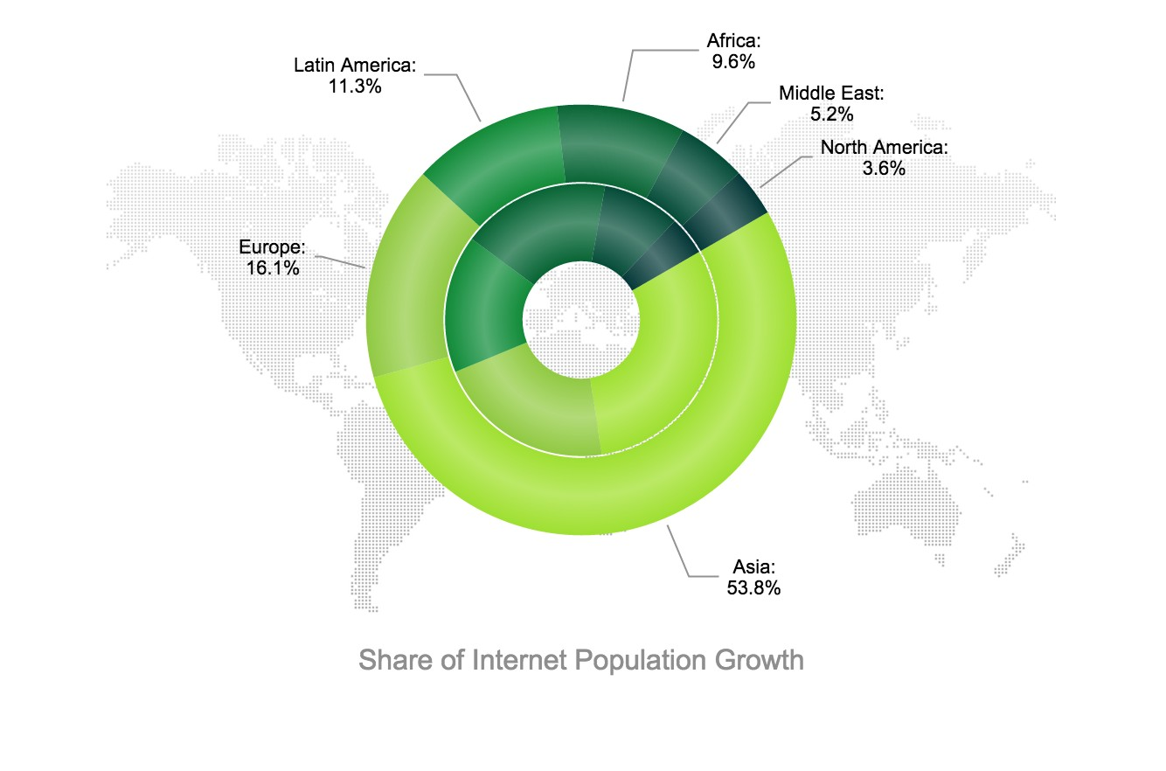
And Everything in Between
A Kendo UI Donut Chart

Slide 14

Application Framework
Everything ready out of the box
DataSource
Single Page Application (SPA)
Globalization
Templates
MVVM
Validators
Effects
Drag-And-Drop
AngularJS Integration
Bootstrap Friendly

Slide 15

Let's code

Slide 16
First, set References
You can do local or use hosted CDNs
<!DOCTYPE
<html>
<head>
<link
<link
html>
rel="stylesheet" href="styles/kendo.common.min.css"
rel="stylesheet" href="styles/kendo.default.min.css
<script src="js/jquery.min.js"></script>
<script src="js/kendo.all.min.js"></script>
</head>

Slide 17
How do I use Kendo UI?
Well, you know jQuery right?
<div id="calender"></div>
// Select the 'calendar' div
$('#calendar');

Slide 18

That's all
You already know Kendo UI!
<div id="calendar"></div>
// Select the 'calendar' div
// Turn it into a Kendo UI Calendar
$('#calendar').kendoCalendar();
This is Imperative Initialization

Slide 19

Or use semantic HTML
A </div> is a div .. readable markup
<div id="calendarControl" data-role="calendar"></div> kendo.init(document.body);
This is Declarative Initialization Use 'data-*' attributes

Slide 20
Widget configuration # 1
Use Properties
<div id="palette" />
$("#palette").kendoColorPalette({ columns: 4,
palette: [
"#f0d0c9", "#e2a293", "#d4735e", "#65281a",
"#eddfda", "#dcc0b6", "#cba092", "#7b4b3a"
]
});

Slide 21
Widget configuration # 2
Or use 'data-*' attributes
<div id="pallette" data-role="colorpalette" data-columns="4"
data-palette: "[
'#f0d0c9', '#e2a293', '#d4735e', '#65281a',
'#eddfda', '#dcc0b6', '#cba092', '#7b4b3a']">
</div>
Same results ...

Slide 22



Let's talk Framework
Out-of-box features of Kendo UI
MVVM
Templates Data Source

Slide 23

ViewModel Bindings
Built-in MVVM Pattern
<h1 data-bind="html: title"></h1>
<input data-role="slider" data-bind="value: amount" min="0" max="100">
var viewModel = kendo.observable({ title: 'Hello World!',
amount: 50
});
kendo.bind(document.body, viewModel);
Bindings are 2-Way!

Slide 24
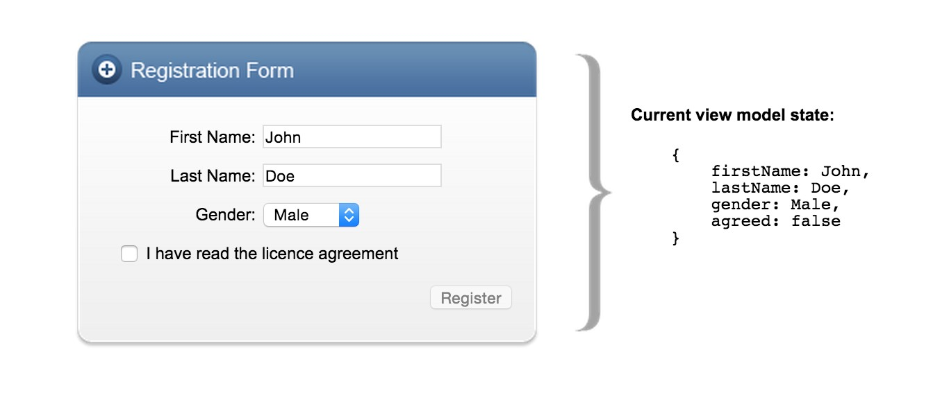
MVVM in Action
UI & ViewModel always in Sync

Slide 25

Templates are Slick
Named & Parameterized
<script id="someTemplate" type="text/x-kendo-template"> Hello, #= firstName # #= lastName #
</script>
<script>
var scriptTemplate = kendo.template($("#someTemplate").html var scriptData = { firstName: "John", lastName: "Doe" };
// Guess the output?
$("#script").html(scriptTemplate(scriptData));
</script>
Use as repeatable markup!

Slide 26
Data Source
A Developer's best friend!
Proxy for Data bindings with Kendo UI widgets
Works with local or remote data
Consistent API
Easy CRUD operations on data source
Shareable between widgets
Paging, Sorting, Filtering - client/server side

Slide 27
Data Source Hookup
Remote data bindings
<div id="products"></div>
<script type="text/x-kendo-template" id="template">
<h3>#:ProductName#</h3>
</script>
<script>
$(function() {
var template =
kendo.template($("#template").html());
var dataSource transport:
= new kendo.data.DataSource({
{
read: {
url: "http://demos.telerik.com/kendo-ui/service/Products", dataType: "jsonp"}
},
change: function() {
$("#products").html(kendo.render(template, this.view()));}
});
dataSource.read();
});
</script>

Slide 28
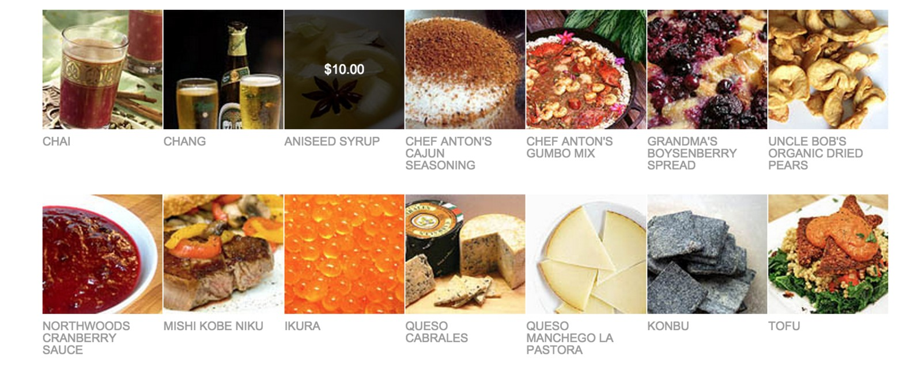
Data Source in Action
Seeing is believing

Slide 29
Easy CRUD Operations
Configure service endpoints
var crudServiceBaseUrl = "http://demos.telerik.com/kendo-ui/service"; var
dataSource = transport:
read:
new kendo.data.DataSource({
{
{
url: crudServiceBaseUrl + "/Products", dataType: "jsonp"
},
update: {
url: crudServiceBaseUrl
},
destroy: {
url: crudServiceBaseUrl
},
create: {
url: crudServiceBaseUrl
}
+ "/Products/Update", dataType: "jsonp"
+ "/Products/Destroy", dataType: "jsonp"
+ "/Products/Create", dataType: "jsonp"
},
batch: true, pageSize: 20
});

Slide 30
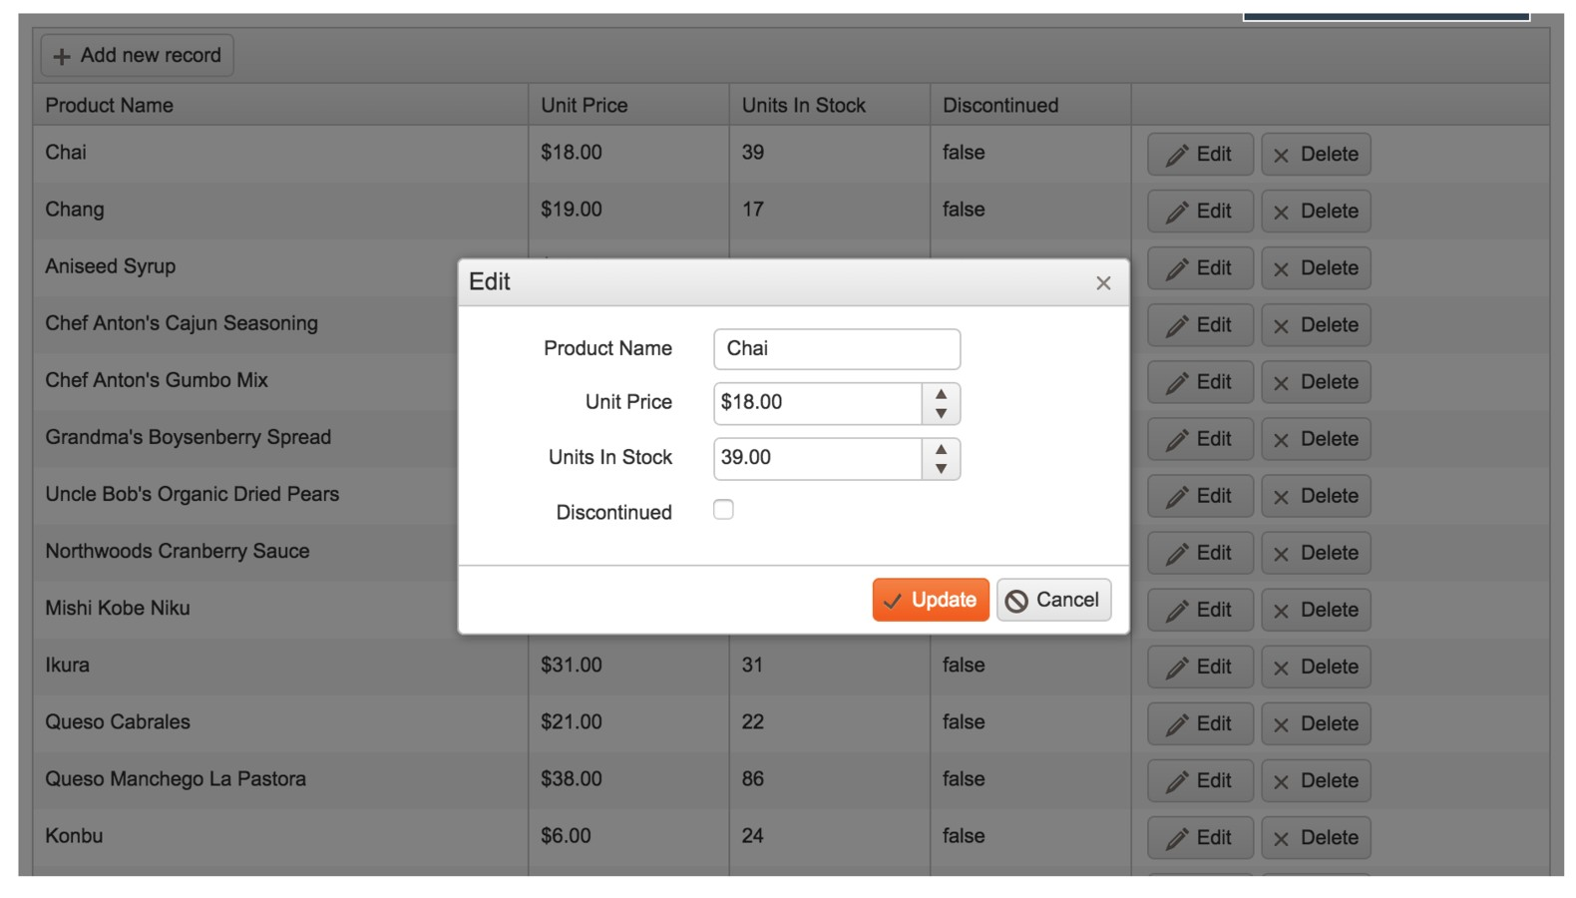
Data Edits Simplified
Grid Edit Modes - Inline/Popup/Batch!

Slide 31

I get the Chi .. how do I start?

Slide 32

We love Open Source
Kendo UI Core is on GitHub - Use it. Fork it.
Application Framework
Web UI Mobile UI
Yup, it's Free .. there is no catch!

Slide 33

Kendo UI Professional
For Enterprise apps
Grid | PivotGrid
Barcode | QR Code
Scheduler | Gantt
Editor | Upload
Gauge
Diagram
Map
Data Visualization | ~20 Types
Feature-rich with consistent API

Slide 34



Server-Side Wrappers
Renders HTML5 Kendo UI Widgets
ASP.NET MVC PHP
JSP
Pick your server stack!

Slide 35
Angular JS Integration
Directives to render Kendo UI Widgets
<script src="js/jquery.min.js"></script>
<script src="js/angular.min.js"></script>
<script src="js/kendo.all.min.js"></script>
<div id="example" ng-app="KendoDemo">
<div ng-controller="AutoComplete">
<h4>Select Telerik Product: </h4>
<input kendo-auto-complete ng-model="product" k-data-source="productNames"/>
</div>
</div>
<script>
angular.module("KendoDemo", [ "kendo.directives" ])
.controller("AutoComplete", function($scope){
$scope.productNames = [ "Telerik Kendo UI", "Telerik AppBuilder", "Telerik UI for ASP.NET"
];
})
</script>

Slide 36

Let's hit the SPA ...

Slide 37



App Building Blocks
SPA Components Routers Layouts
Views
Everything you need - out of the box!

Slide 38
Router
SPA Components Breakdown
Tracks application state
Manages navigation between states Integrates into browser history stack
Application states become bookmarkable
Supports parameters for routes to entities

Slide 39
Router in Action
URL Change fires events
<div id="demo">
<a href="#/">Home</a>
<a href="#/about">About</a>
</div>
var router = new kendo.Router(); router.route('/', function(e) {
// Event Handler
});
router.route('/about', function(e) {
// Event Handler
});
router.start();

Slide 40
Layouts & Views
SPA Components Breakdown
Layout is the container for Views View is a chunk of markup
Views have a corresponding ViewModel Views render when URL changes

Slide 41
Layout in Action
Like a container Master page
<div id="demo"></div>
<script type="text/x-kendo-template" id="layout">
<div id="layout">
<ul data-role="menu">
<li><a href="#/">Home</a></li>
<li><a href="#/about">About</a></li>
</ul>
</div>
</script>
var layout = new kendo.Layout('#layout'); var router = new kendo.Router({
init: function() { layout.render('#demo');
}
});
router.start();

Slide 42
View in Action
HTML markup with ViewModel binding
var homeModel = kendo.observable({
title: 'Home'
});
var home = new kendo.View('#home',{ model: homeModel });
var layout = new kendo.Layout('#layout'); var router = new kendo.Router({
init: function() { layout.render('#demo');
}
});
router.route('/', function(e) { layout.showIn('#someContainer', home);
});
router.start();

Slide 43
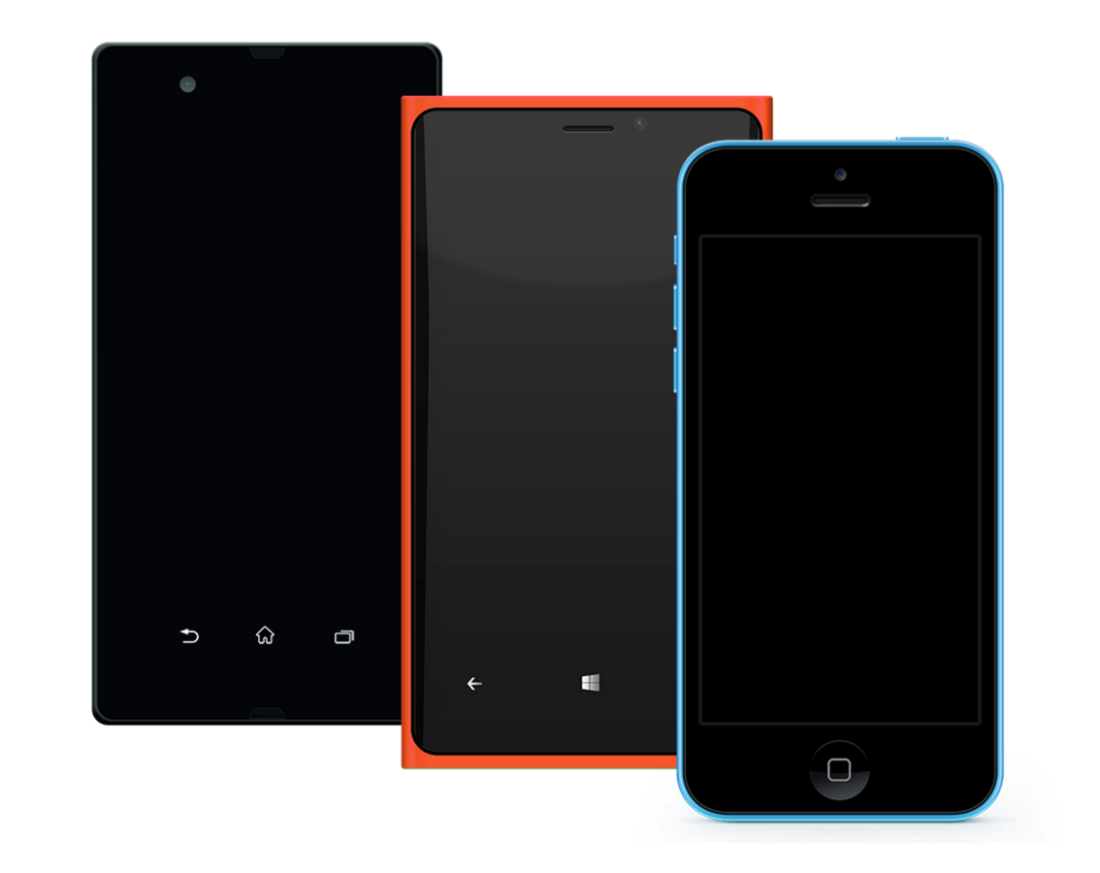
Let's talk Mobile ...
Use Web skills to make Mobile Apps!

Slide 44






Kendo UI Mobile
Build Hybrid or Mobile Web apps
Completely Open Source & Free!
Bower install to any project
Has Angular Directives to render
Totally Cross-Platform

Slide 45


Hybrid Mobile Apps
Kendo UI Mobile powered
Best with AppBuilder
Use Cordova Plugins for Native API
Respective App Store presence

Slide 46
Remember the UI Widgets
A complete application toolset for building hybrid and mobile web applications
ActionSheet ButtonGroup Drawer Forms ListView MobileButton ModalView NavBar PopOver Scroller
ScrollView SplitView Switch TabStrip

Slide 47
Mobile App Architecture
Building Blocks with Kendo UI Mobile
Kendo UI Mobile includes App Framework App container initializes all UI widgets Apps are made of Views
Views can share Layouts - like TabStrips or NavBar Heavy usage of 'data-*' attributes
UI Widgets render adaptively or use Flat theme Transitions add to Native feel
True single code base for Cross-Platform apps

Slide 48
Kendo UI Mobile Basics
Views, Layouts & Initialization
<div class="app">
<div data-role="view" data-title="Home" id="home" data-layout="main"></div>
<div data-role="view" data-title="About" id="about" data-layout="main"></div>
<div data-role="layout" data-id="main">
<div data-role="header">
<div data-role="navbar">
<span data-role="view-title"></span>
</div>
</div>
<div data-role="footer">
<div data-role="tabstrip">
<a href="#home" data-icon="home">Home</a>
<a href="#about" data-icon="about">About</a>
</div>
</div>
</div>
</div>
// Initialization
new kendo.mobile.Application('.app');

Slide 49


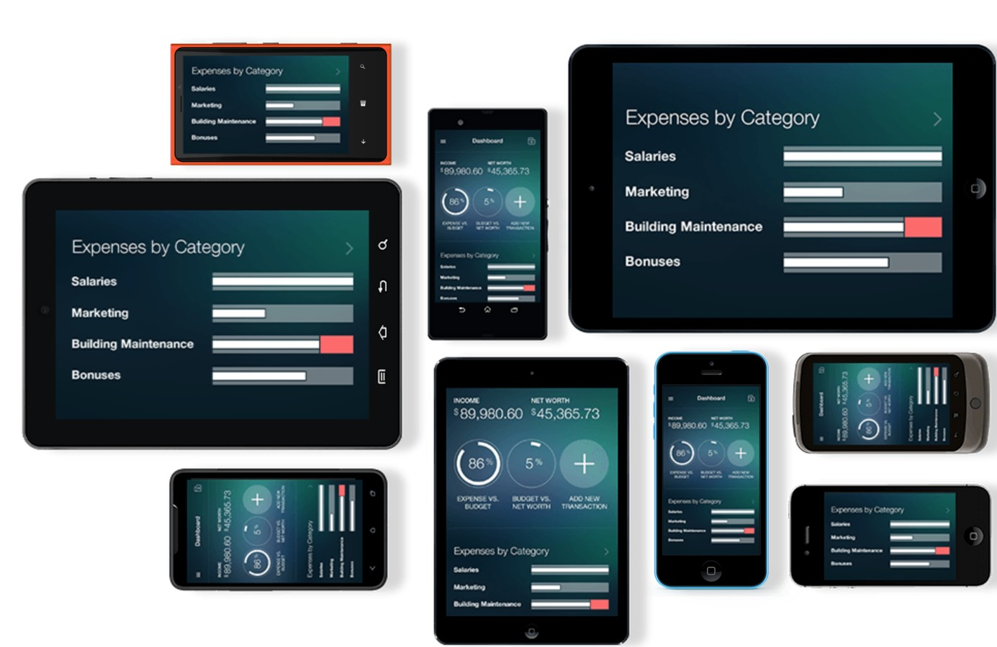
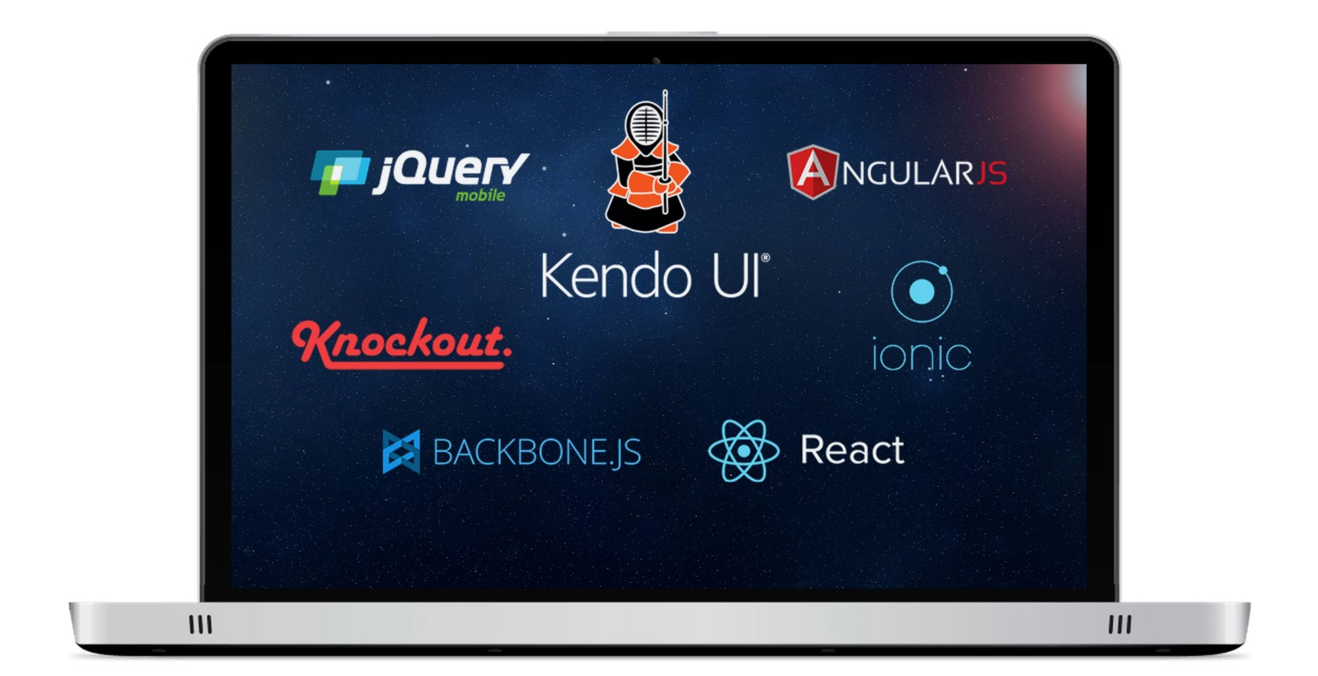
Kendo UI Mobile
Flexibility for Developers
Offline capabilities Flat Themes
OS Adaptive Rendering
Plays well with others

Slide 50



Feel the Zen
Tooling that truly helps
Interactive Dojo Web ThemeBuilder
Mobile ThemeBuilder
Chrome Inspector Demos | Forums | Docs

Slide 51


To Recap ..
Something for everyone
Kendo UI Core
Application Framework | Web | Mobile | Completely Free
Kendo UI Professional
Enterprise UI | Licensed per Developer | Support & Maintenance

Slide 52

Modern Web & Mobile Done Right!
kendoui.com | @KendoUI

